Slide 1
Visiting the Middle East in the Time of Terror
Presented by
Venise Grossmann

Slide 2
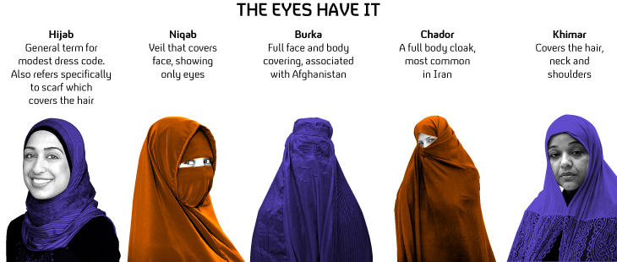
Muslim Clothing for Women

Slide 3
Middle East

Slide 4
Countries Visited
Egypt
Turkey (Istanbul)
United Arab Emirates (Dubai)
Oman
Iran
Israel
Palestine
Jordan
Qatar (Doha)
Bahrain
Lebanon

Slide 5
Egypt

Slide 6
Egypt

Slide 7
Turkey

Slide 8
United Arab Emirates

Slide 9
United Arab Emirates

Slide 10
United Arab Emirates

Slide 11
United Arab Emirates

Slide 12
Oman

Slide 13
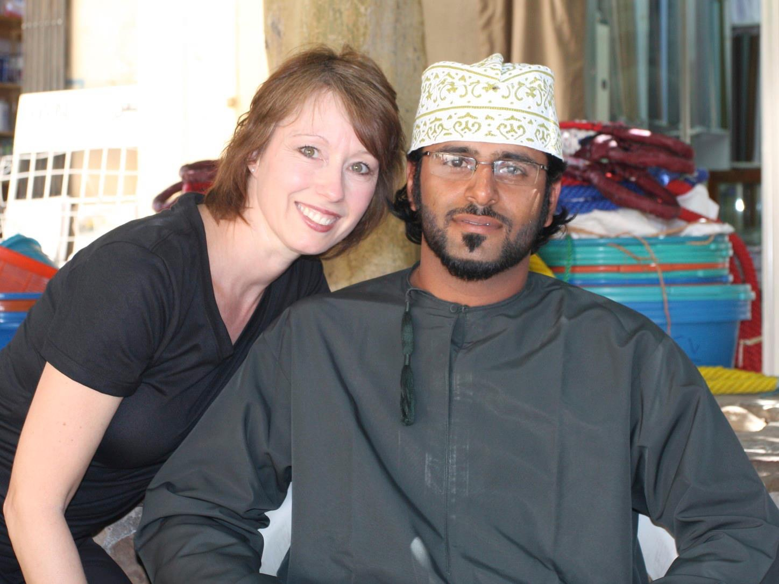
Oman

Slide 14
Oman

Slide 15
Iran

Slide 16
Iran

Slide 17
Iran

Slide 18
Iran

Slide 19
Iran

Slide 20
Iran

Slide 21
Iran

Slide 22
Iran

Slide 23
Israel

Slide 24
Israel

Slide 25
Israel

Slide 26
Israel

Slide 27
Israel

Slide 28
Palestine

Slide 29
Jordan

Slide 30
Jordan

Slide 31
Jordan

Slide 32
Jordan

Slide 33
Jordan

Slide 34
Jordan

Slide 35
Jordan

Slide 36
Jordan

Slide 37
Jordan

Slide 38
Jordan

Slide 39
Jordan

Slide 40
Qatar

Slide 41
Qatar

Slide 42
Qatar

Slide 43
Bahrain

Slide 44
Bahrain

Slide 45
Lebanon

Slide 46
Lebanon

Slide 47
Lebanon

Slide 48
Lebanon

Slide 49
Lebanon

Slide 50
Countries Not Visited
Cyprus
Iraq
Kuwait
Saudi Arabia
Syria

Slide 51
Why I Enjoyed the Middle East
Learning About the Culture
Experiencing the conditions (heat/sand)
Gaining a better understanding of what our deployed troops experience
Better understanding of how the common people feel about Americans
Meeting many new friends

Slide 52
Hafiz
“I have come into the world to see this: the sword drop from men’s hands even at the height of their arc of rage, because we have finally realized there is just one flesh we can wound.”

